Slide 1
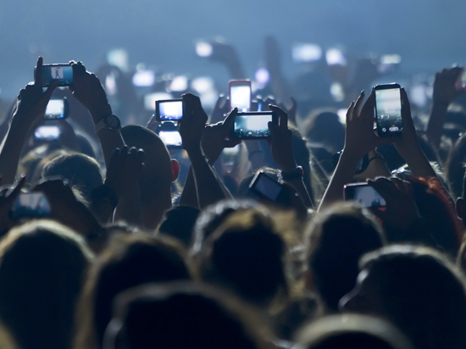
Social technologies and social data to change and predict health behavior

Slide 2

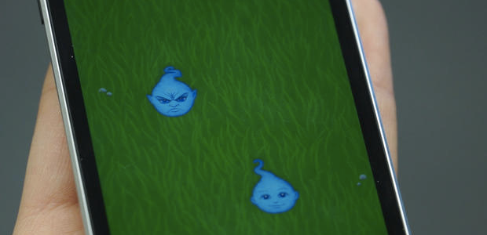
http://www.cbsnews.com/videos/can-a-mobile-game-reduce-anxiety
Notes:
Smartphone game designed to reduce anxiety shows promise in study - still waiting on enough evidence which continues as a theme

Slide 3

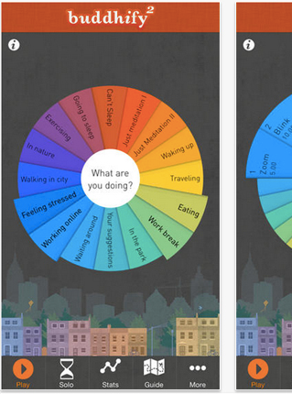
current tech being used
current research being done
suggestions for future research
Notes:
The three main points you wanted to make
image is buddhify - a meditation and mindfulness app

Slide 4

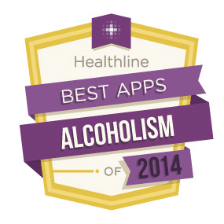







Notes:
These are The Best Apps for Recovering Alcoholics currently in app stores:
from left to right: Stop Drinking with Andrew Johnson (made by a hypnotist), Biblical Encouragement - Alcohol Addiction (bible verses), wenty-Four Hours a Day (meditation and prayers over horrifying pictures made by a Christian company), AlcoDroid Alcohol Tracker (has a BAC calculator and is a tracker for people monitoring for all sorts of reasons), SoberApp - Alcohol Calculator (BAC calc with built in taxi service to help people avoid driving drunk)
This space is still the wild west. Most of these apps aren’t evidence based and involve a heavy religious or spiritual component. Some of them use fear and pictures of dead drug addicts. There’s a need for more evidence based apps that have valid measures and quantifiable data.

Slide 5

Notes:
There are no apps approved nor any “mobile” interventions.
There are 13 “online” interventions approved and most of them are prevention or education for school children. The NREPP covers both mental health and substance abuse interventions.

Slide 6
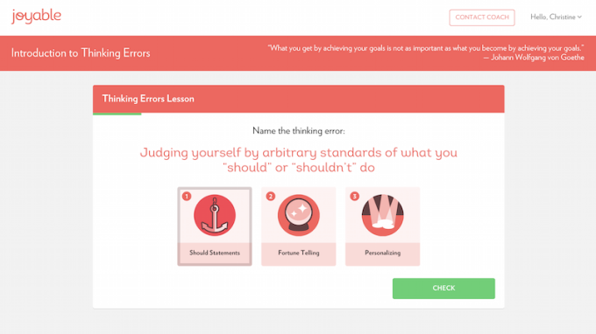
Notes:
Mental health fares better in terms of evidence based, at least evidence for the method in a clinical setting, if not enough data on how they fare on mobile devices
There are also apps that claim to cure autism, that are advertised in the same space but claim to analyse your dreams scientifically and a lot of other questionable goals so, it’s clear that regulation is spotty
People are working on it though. This is Joyable and it uses CBT to help their users with social anxiety. They have solid clinical people on their advisor board and it’s a 12 week program. also connects users to a personal coach via text or phone for the program. users report a 90% success rate so far

Slide 7
Notes:
There are some online resources for opioid dependence but they’re part of larger interventions as sort of a side bonus

Slide 8



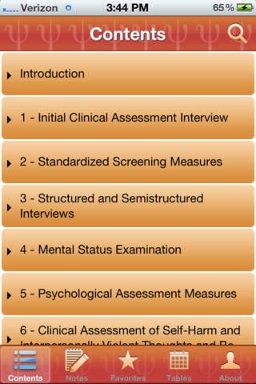
Notes:
There are also resources from the clinical side that are more regulated:
PsycEssentials
By American Psychological Association PsycEssentials is a comprehensive pocket resource for busy psychotherapists. It provides quick and easy access to the key information you need when working with a client. If you are looking for an appropriate assessment tool, state-by-state referral resources, or information on a psychotropic drug, you will find it here. Beyond checklists and links, the app

Slide 9
Notes:
AdhereTech smart wireless pill bottles are currently being used by patients in pharmaceutical and research engagements. These bottles collect and send all adherence data in real-time. The system automatically analyzes this information and populates the data on our secure dashboard. If doses are missed, patients can receive customizable alerts and interventions - using automated phone calls, text messages, and more

Slide 10
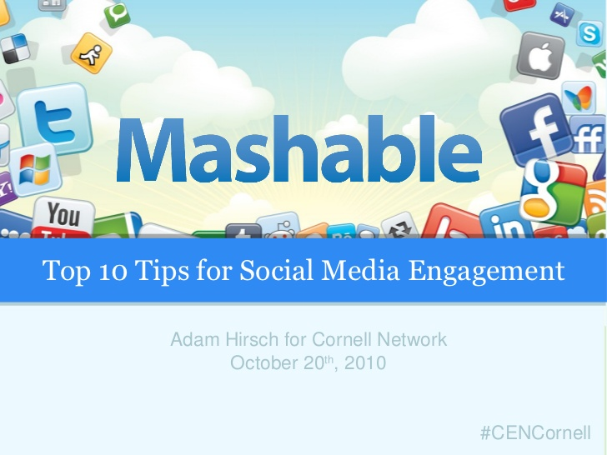


The HOPE Approach:
Social Media for HIV Prevention and Care
Sean D. Young, PhD, MS
UC Institute for Prediction Technology
IAPAC Adherence
June 28, 2015
Notes:
Get demographics background. Tell joke about stanford and facebook.
People talk about mobile technologies for interventions and social media for outreach and recruitment. These fields are in their infancies, but I think we need to focus on how to integrate technologies together, and will give a number of examples from my work of how to do that.

Slide 11
Funding
NIH
UCOP

Slide 12
Objectives
Identify the role that social media can play in the HIV care continuum
Learn about the HOPE intervention
Ability to adapt it for HIV care

Slide 13
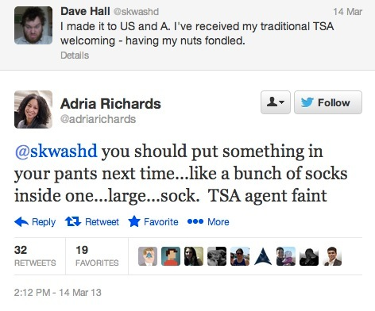

Slide 14
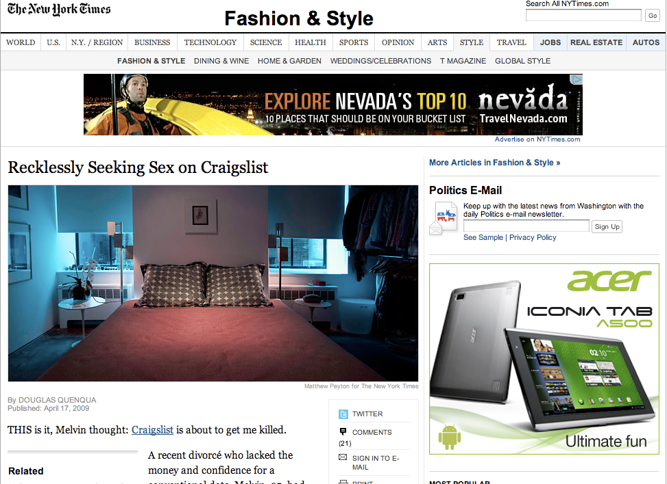

Slide 15
HIV/AIDS Epidemiology
African Americans and Latinos in Los Angeles at high risk for HIV
Men who have sex with men (MSM) account for over 3/4 of all infections

Slide 16
Community-based HIV
Prevention Methods
Community-based HIV prevention is powerful
Often make use of social networks and social connectedness, such as peer leader diffusion of innovations interventions
But it has limitations
Price
Access
Location/time
Stigma
Can social media be used to overcome the limitations?

Slide 17
Using The Internet to Scale
HIV Prevention Interventions
Internet interventions are easily scalable
Quickly recruit participants to chat sites
Allow large audiences to receive HIV prevention/testing information (Bowen et al., 2008)
Timely
In the past, interventions could only focus on upper middle class White populations
SES differences in Internet access are disappearing/changing (Pew Research, 2007; 2008; 2011).
Using Internet technologies might be a cost-effective way to scale HIV prevention within high-risk groups.

Slide 18
Reduce Scientist-Practitioner Lag
Internet “sex seekers” at high-risk
Use modern methods of finding sex partners to reduce stigma
Craigslist
Dating sites
Social networking sites
Research, practice, and policy need to keep up to date with sex risk practices

Slide 19
Benefits of Social Media
Technologies For HIV Prevention
Social media/mobile technologies are designed for for social interaction
Allow users to:
befriend and find mutual friends
post and share pictures, videos, and other multi-media
have an online persona that can be publicly or privately available for other users
Access profiles from computers and cell phones
Notes:
Talk about important of “social”

Slide 20
Digital Divide Is Decreasing
2000-2010, African American/Latino Internet users increased from 11% - 21%
In California, 58% of Latinos access the Internet (63% of Californians)
Among Internet users, 70% African Americans and English-speaking Latinos use social networking sites, 60% Whites
50% of African Americans visit OSN daily, 33% of Whites

Slide 21
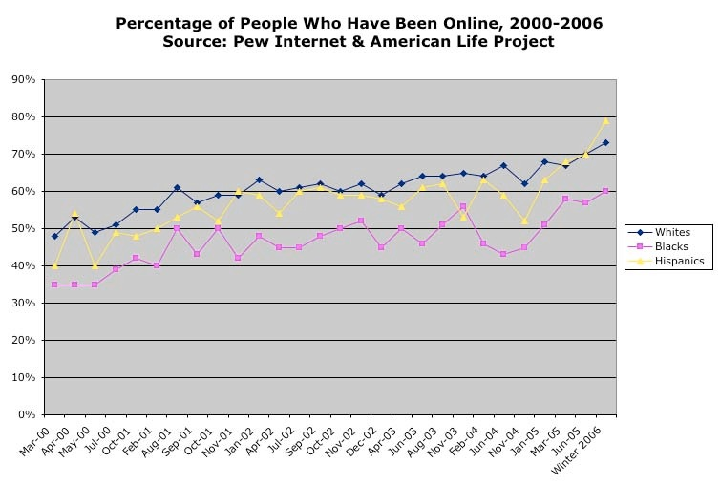

Slide 22
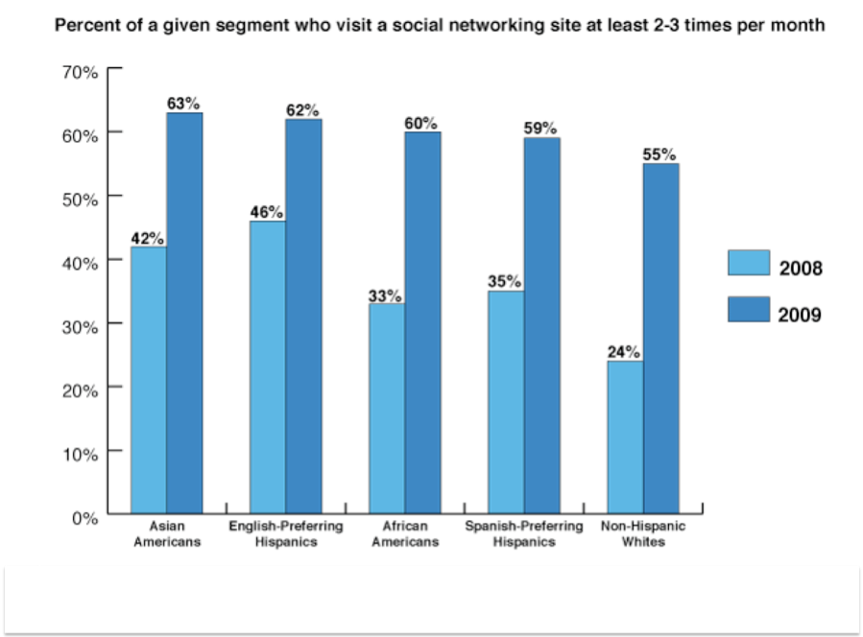
Notes:
The rapid growth of social networking technologies among high-risk populations provides an opportunity for health researchers to use social networks for health research. For example…
This presentation focuses on how social networking can be used for mixed-methods (quant and qual) health researchI will focus on mixed-methods HIV prevention by looking at a study among people at risk for HIV.

Slide 23
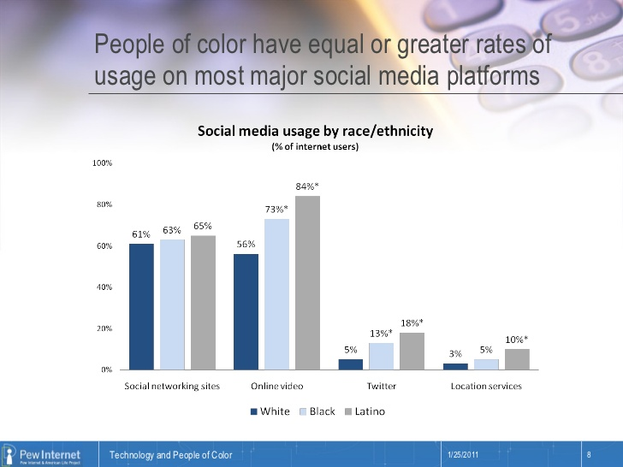

Slide 24
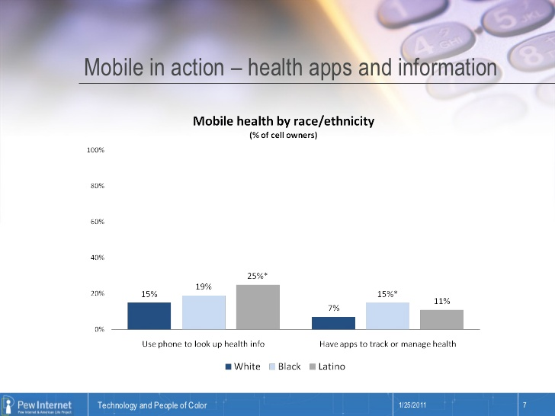

Slide 25
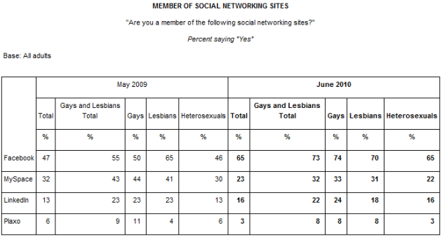
Notes:
753,040 U.S. Facebook users report being men who are interested in men
138,700 of these users (18.4%) live in California

Slide 26
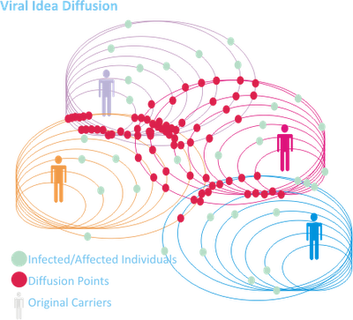

HOPE
For HIV Prevention and Care
Using social media for HIV prevention/ sex education
Peer-Leader Diffusion Model

Slide 27
Sample
Sample:
Primarily Latino and African American men who have sex with men (MSM)
Living in the Los Angeles area
120 participants
18 peer leaders

Slide 28
Intervention Methods
Control group Peer leaders discuss general health topics
Experimental Group Peer leaders discuss HIV education topics
Aims:
Home-based HIV testing
Self-reported sexual behaviors
Reduction in stigma

Slide 29






Peer Leader Recruitment Plan
Partnering with Community Outreach
Fliers
Discussion Boards
Live Presentations

Slide 30
Participant Recruitment Plan
(Offline) Print Advertisements
Adalante, Weho News, Vanguard Newsletter
(Offline) Flier
Restaurants, clubs, bars
(Online) Social media:
Banner ads + “Fan” Pages
Dating sites: Adam4Adam, Gay.com
Networking sites: Twitter, Facebook

Slide 31
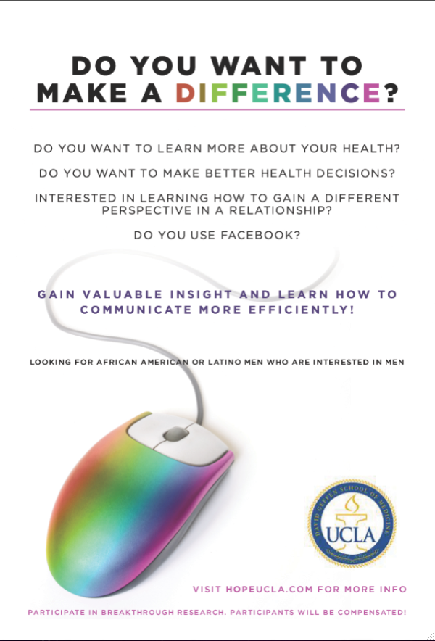

Recruitment

Slide 32
Recruitment Sequence
Expressed Interest
Directed to Website
Pass Screening Process
Fail Screening Process
Sign Consent Form
Reject Consent Form
Sample:
122 Registered
Participants

Slide 33
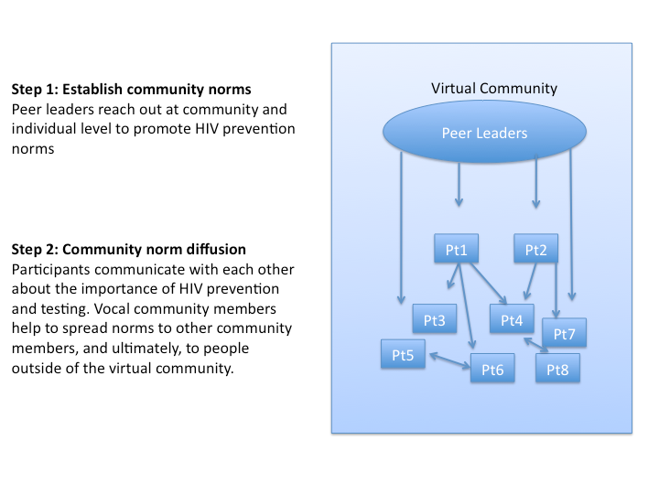

Slide 34
Results
Retention rates were >90% at 12-week follow-up
Home-based HIV testing was an acceptable method of testing among these groups
Intervention differences¹⁰:
Increased home HIV testing requests
Decreased unprotected sex among intervention group participants
Initial results suggestion intervention diffusion
Among intervention group, increased network growth associated with HIV prevention
Established initial standards for use of social mHealth in HIV prevention research ¹¹

Slide 35
Results
Feasible to recruit/train minority MSM peer leaders ^{1,2}
Feasible to recruit minority MSM participants ³
AA MSM less likely to engage in unprotected receptive anal intercourse compared to Latino MSM ⁴
Number of partners met on social networks associated with:
1) exchanged sex
2) number of new partners,
3) number of male sex partners,
4) frequency of engaging in oral sex 5

Slide 36
Results
High rates of stimulant drug use among the sample
> 1/3 used social networks to seek sex
more likely to have used methamphetamines in the past 12 months ⁶
Participants were highly engaged and shared personal information
HIV prevention discussions increased over study, demonstrating effectiveness
Conversation associated with > HIV testing requests
Social networking can be a tool for mixed (qualitative and quantitative) methods ^{7,8}

Slide 37
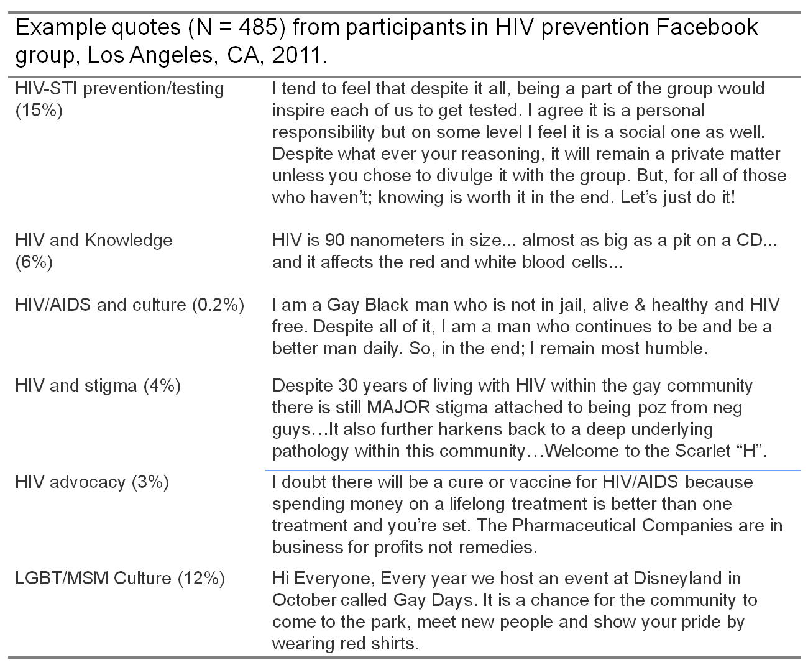

Slide 38
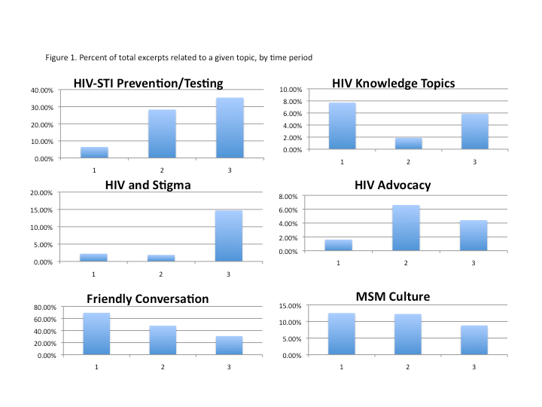

Slide 39
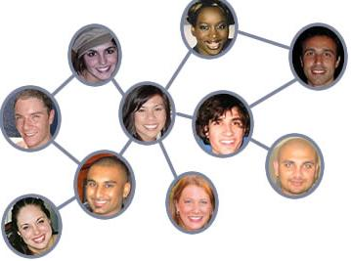
Follow-up: Online Social Network Diffusion
HOPE participants contacted friends
Friends completed a survey
Sexual risk behaviors and drug use

Slide 40
Conclusion
Facebook can be used as a tool for HIV prevention interventions
Results are associated with changes in network growth
Results generalize to other populations and regions
Replicated in Peru among Peruvian MSM

Slide 41
Conclusions
Social media continues to rapidly grow
HOPE can be used for HIV prevention/testing and applied for HIV care

Slide 42
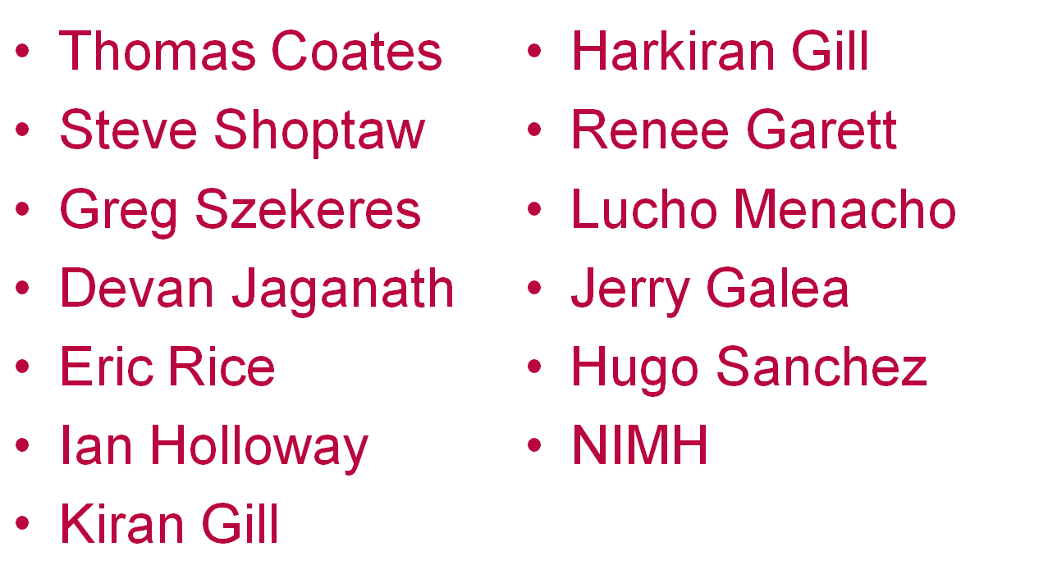
Thank you

